Slide 1
Notes:
This presentation will introduce the Galapagos Giant Tortoise and how it is adapted to its environment.
Galapagos Giant Tortoises can be found in varying habitats and the presentation is designed to get students this about how and why this may be.
It will also examine why it is important that scientists and researchers are learning about the tortoises by tracking them in the wild.

Slide 2
Galapagos Giant Tortoises
What habitats to they need?
How are the different types adapted to their environment?
How can we protect them?
Notes:
These are the key questions to be discussed during this presentation.

Slide 3
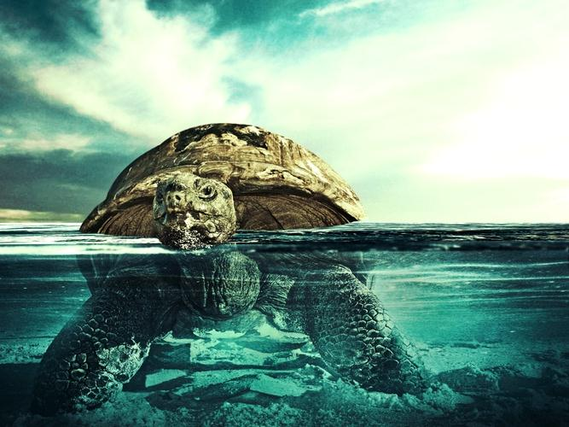
It is likely that the 10 species of giant tortoise living on the Galapagos Islands all evolved from a common ancestor.
Notes:
How did Giant Tortoises come to live on the Galapagos islands? Using the image on this slide as a clue, students can discuss how they think Tortoises came to live in the Galapagos Islands from the mainland. It is likely that their common ancestor floated to the Islands from the mainland on ocean currents.
Students can also be asked if they can name any other animals live in Galapagos and how do they think they got there?

Slide 4
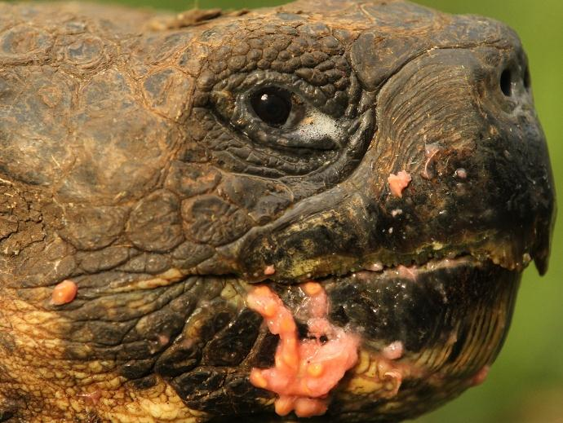
Notes:
This slide can be used to ask students what they think this tortoise has been eating – it has been eating guava fruit which has been found on the ground.
This introduces that one of the key factors for adaptations is to help the animal find food.

Slide 5
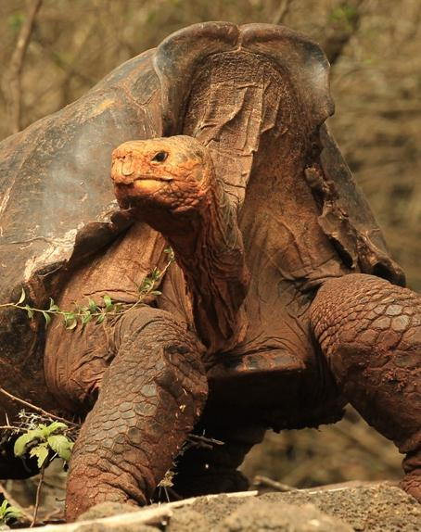
Habitat Adaptation
Notes:
This slide can be used to ask students to spot the differences between the two tortoises, the main difference being the shell. The tortoise on the left with the domed shell lives in a lush environment so can find food on the floor, and therefore this species has not evolved a shell which is raised up at the front like the saddleback tortoise on the right in the arid habitat, which needs to reach food higher off the ground, such as cacti.

Slide 6
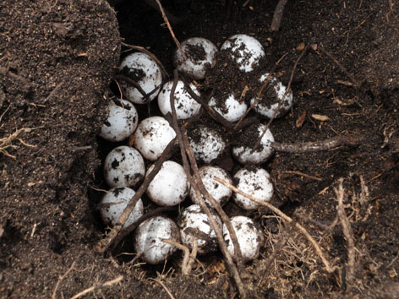
Female giant tortoises can travel up to several miles to their nesting areas of dry, sandy ground to lay their eggs, they lay between 2 -16 eggs the size of tennis balls!
Notes:
No matter what kind of habitat the giant tortoise normally live in, the females must always get to a sandy environment to lay their eggs.

Slide 7
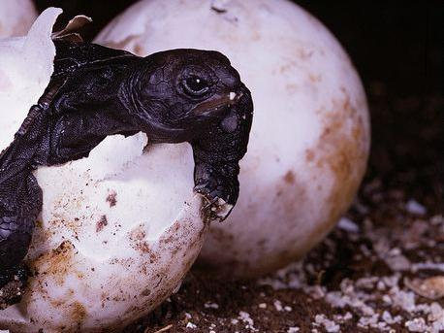
Warm nest temperatures lead to the tortoises becoming female, while cool temperatures increase the likelihood that the hatchlings are male.
Notes:
The warm and cold temperature of a nest effecting the gender of the young is true of all reptiles.

Slide 8
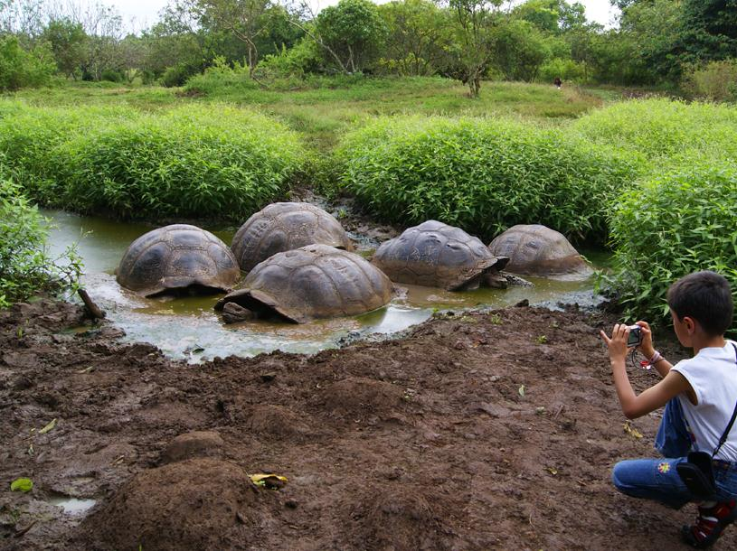
Giant Tortoise can survive for long periods of time without water, but they do love a long drink and a wallow in water and mud pools.
Notes:
Mud pools are another tortoise environment which they use to keep cool.

Slide 9
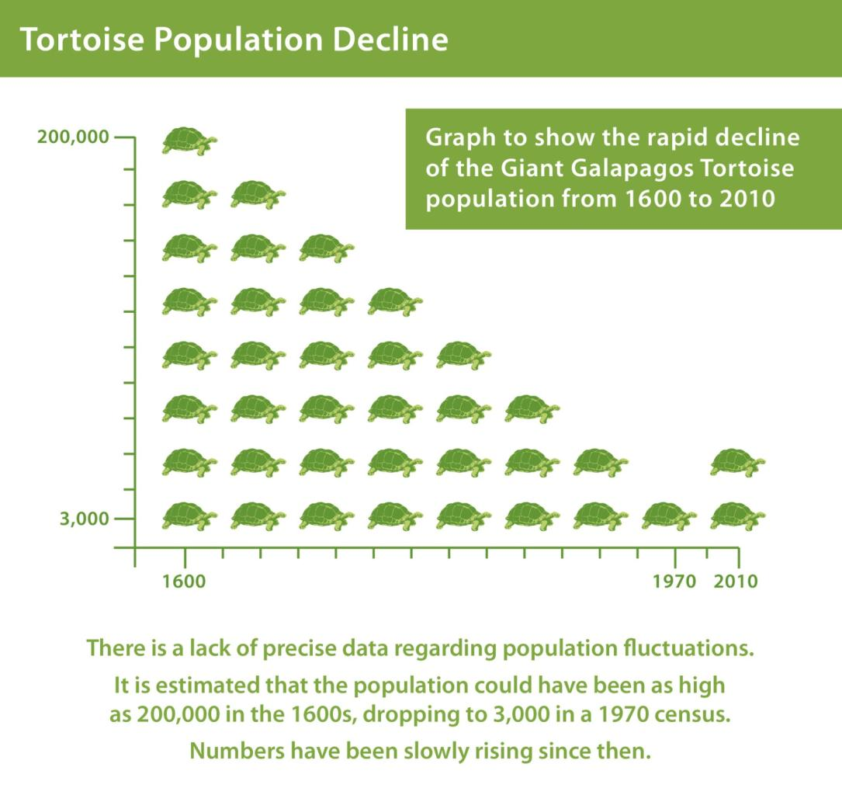
Notes:
There used to be over 200,000 giant tortoises living in the Galapagos Islands, however, pirates, whalers and other visitors to the islands (including Darwin) ate them to the point of near extinction. They were a good source of food for sailors on long journeys because they could live for a long time on boats without any food or water (due to their low metabolic rate), and would therefore provide fresh meat for the travellers on their voyage. However, thanks to recent conservation efforts, the population is increasing again. The next few slides show how scientists and researchers in Galapagos are finding out more about the tortoises so that we can keep conserving them.

Slide 10
Tracking Tortoises:
The Galapagos Tortoise Movement Ecology Programme
Notes:
The Galapagos Tortoise Movement Ecology Programme is headed by Dr Stephen Blake, and uses GPS technology to track Giant Tortoises in their natural habitats. Here you can see Stephen and some of his team tracking the data on their computer. What kind of data do the students think would be useful to know about the tortoises? How can these things be measured? Some ideas:
Where they are going - GPS
How quickly they are moving - Accelerometer
If they are communicating with other tortoises - camera
What they are eating - camera
How they react to changes in environment – heat sensors, cameras and GPS

Slide 11
The trackers are attached to the tortoise shell using high-grade plumbers glue!
Notes:
Here Dr Blake is attaching the tracker to the shell of a tortoise. They have to be stuck to the shell incredibly tightly so they don’t fall off when the tortoises move through the bushes.

Slide 12
Notes:
This tortoise has a critter cam on it’s shell.

Slide 13
Scaling a Volcano
Notes:
The red dots on this map show tortoises moving up and down the volcano.
Why do students think they might move? Examples of reasons could be mating, food availability, finding a suitable place to lay eggs.

Slide 14
Notes:
The blue areas on this map show some of the areas that the Giant Galapagos Tortoises live. These are the areas where Dr Blake and his team are tracking the tortoises. Like the red dots on the map before, the lines show the movement of the tortoises around the islands they live on.

Slide 15
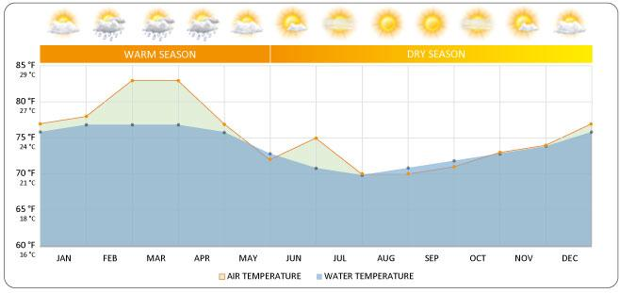
Measuring the Environment
Notes:
There are other ways for the scientists to check the tortoises environment – this slide can be used to ask students why this would be important and how students might think this can be done. Some ideas:
Measuring rainfall
Measuring sunlight
Measuring temperature

Slide 16
Thank you for listening!
For more information visit:
www.discoveringgalapagos.org.uk

